Slide 1

ZOMBIVERSE
Survive the cosmos, one question at a time!

Slide 2
Introduction
Welcome to Zombiverse! This is an interactive space-themed game where players explore different stars and planets while facing challenges and zombies. The game blends fun, learning, and strategy, turning coding into an engaging adventure. Players navigate through questions, life scores, and lucky charms, making every choice count. The goal? To survive, learn, and enjoy a cosmic journey through coding!

Slide 3
How To Play
Sign up and log in. Entering incorrect credentials ends the game.
Choose one of two stars or three planets.
You start with 5 life points. Answer 10 questions about your chosen celestial body.
Wrong answers reduce life by 1.
Lucky charms appear after questions 3 & 7. If the charm shows number 5, gain 1 life!
Survive all questions to win the game.

Slide 4
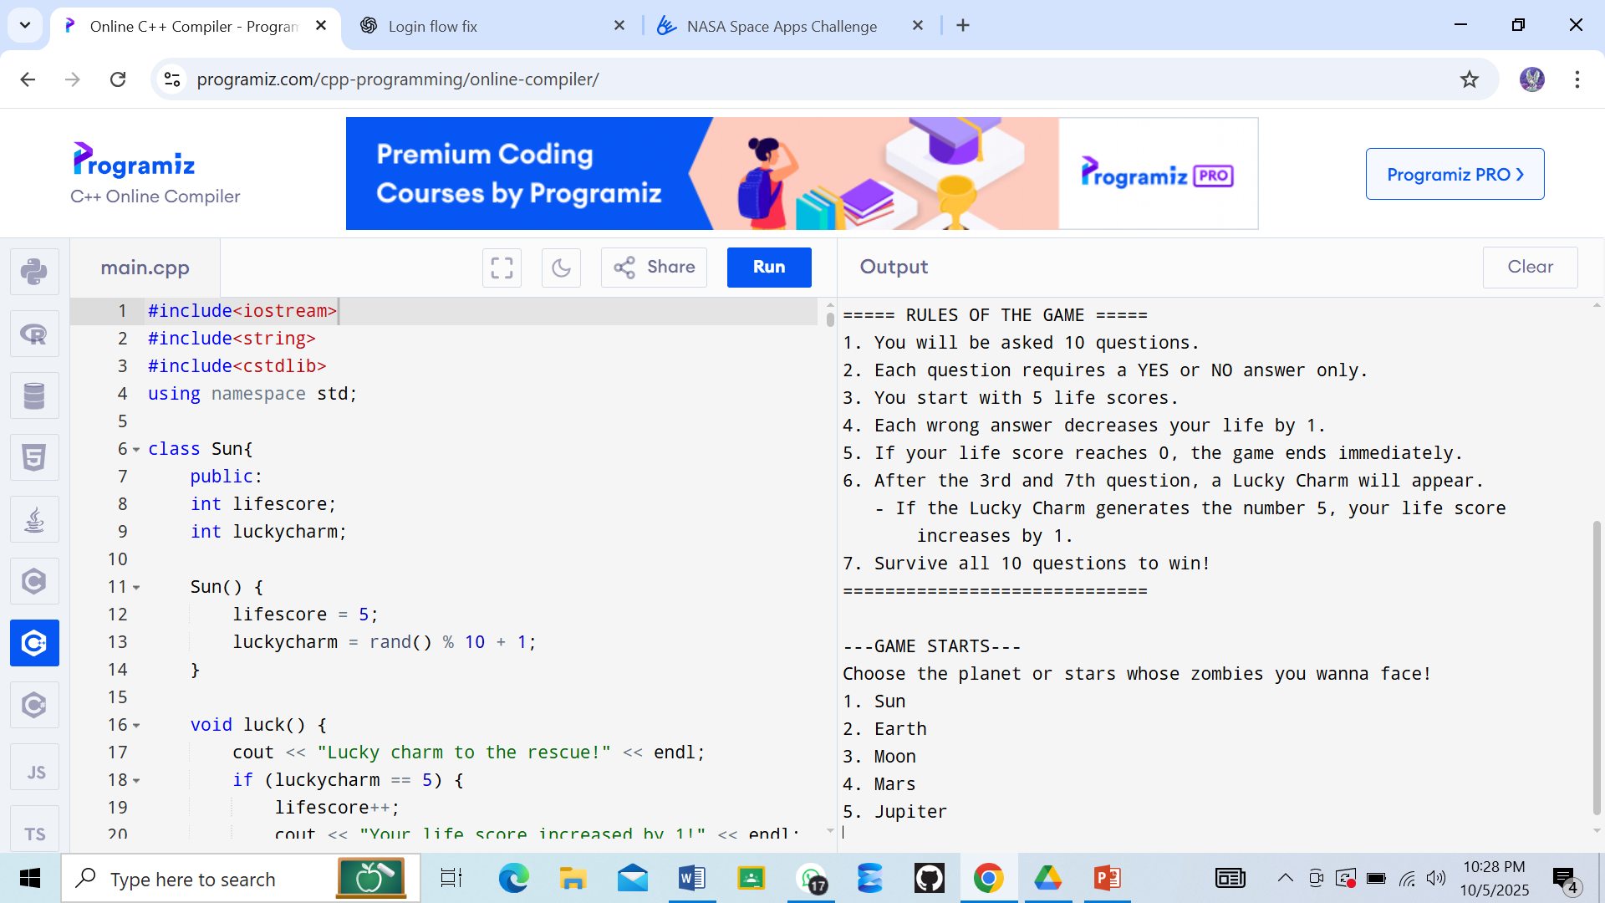
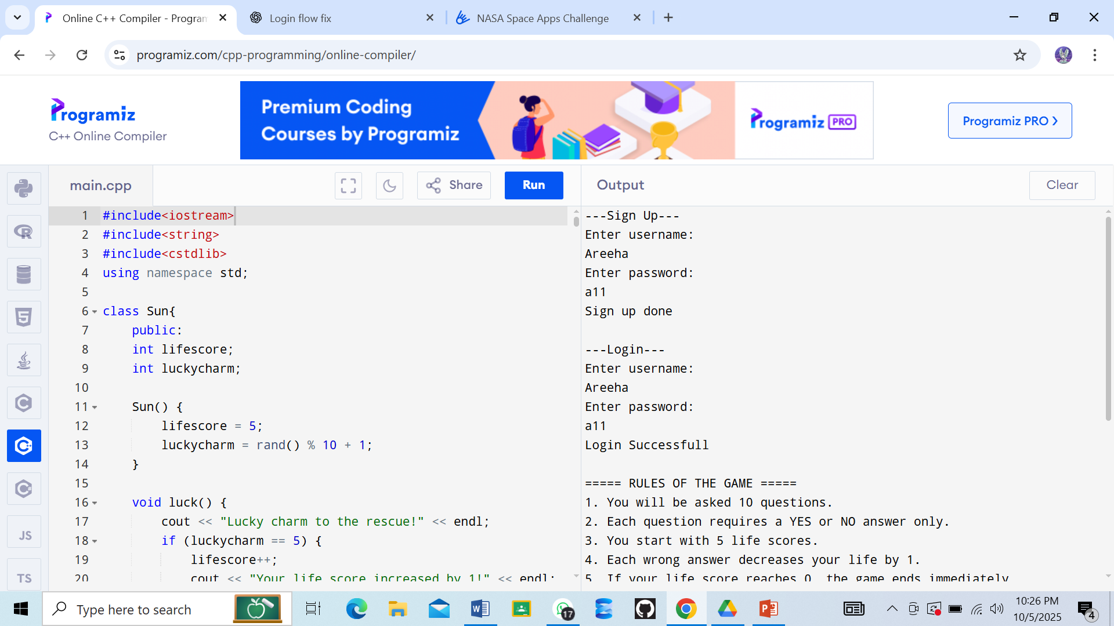
Output

Slide 5
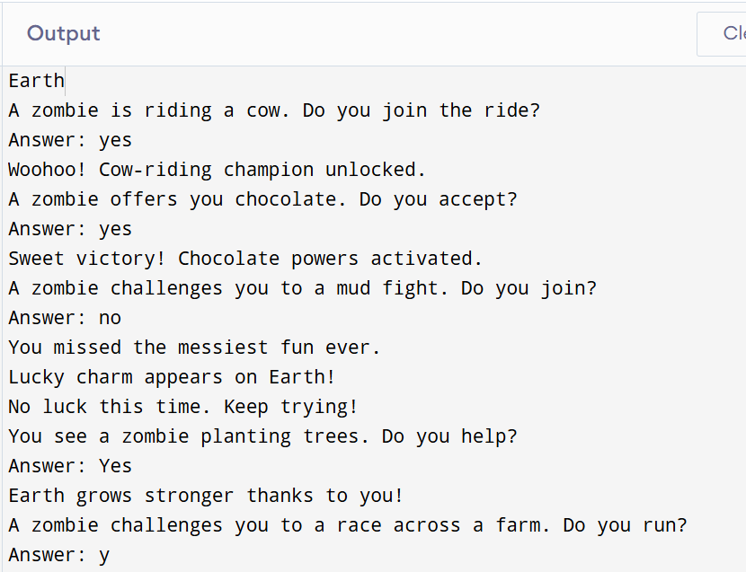

Slide 6
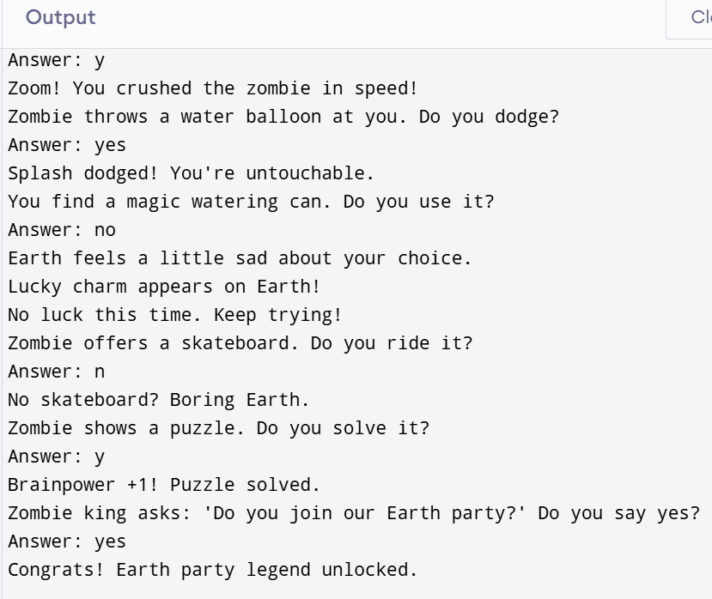

Slide 7
Zombiverse isn’t just a game—it makes coding approachable, interactive, and enjoyable. Players get a fun, lighthearted experience while learning and exploring, bringing smiles as they navigate the stars!
Thanks for checking out Zombiverse!

